Slide 1
Intoxikation och behandling av psykomotorisk oro och agitation
Kai Knudsen
Docent, Överläkare Sahlgrenska Sjukhuset

Slide 2
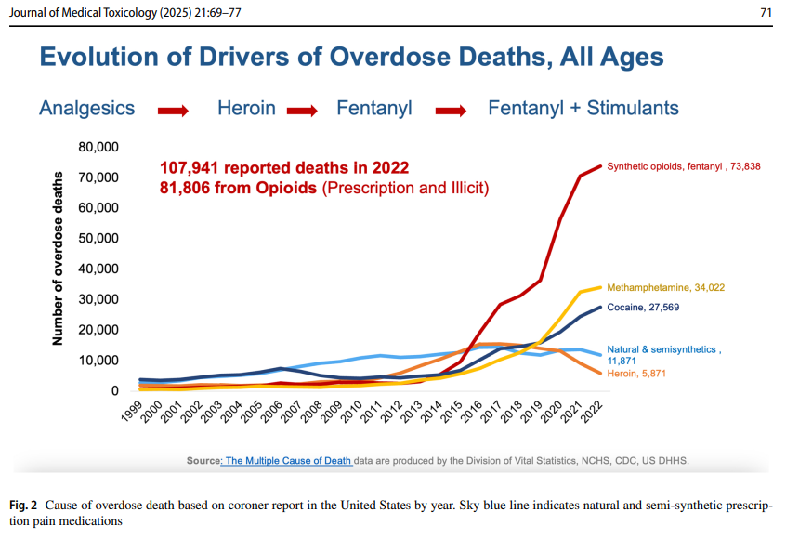

Slide 3
Agitation in alcohol withdrawal – How bad could it get?
Mild withdrawal:
  Anxiety
  agitation
  tremor
  nausea
  disturbed sleep
  tachycardia
  raised temperature
Severe withdrawal:
  vomiting
  extreme agitation
  disorientation
  confusion
  paranoia
  hyperventilation
  delirium tremens
Severe AWS is a potentially life-threatening medical emergency.

Slide 4
Acute recreational drug and NPS toxicity in Europe
12 months data collection from the European Drug Emergencies Network (Euro-DEN)
Most frequently reported clinical features:
• Agitation/aggression: 1467 cases (26.5%)
• Anxiety: 1040 cases (18.8%)
Most common treatment:
• Sedation: 1204 cases (21.8%)

Slide 5
Comparison of Agitation Scales
Scale | Range | Captures Sedation | Captures Agitation | Best for | Used in | Strengths | Limitations
AMSS | −4 to +4 | Yes | Yes | Field/ED; quick bi‑directional mental status screening | EMS, toxicology, trauma, ED | Quick, prehospital friendly; captures sedation ↔ agitation | Less detailed at extremes
RASS | −5 to +4 | Yes | Yes | ICU & ED sedation/agitation monitoring; procedural sedation | ICU, ED, OR/procedures | Validated, reliable; bidirectional scale | Requires more training
BARS | 1 to 7 | No | Yes | Simple agitation severity scoring for ED/EMS | Psych, ED, behavioral health | Fast, easy to use, intuitive | Does not assess sedation

Slide 6
Updates in the Assessment and Management of Agitation
Ashley Curry, Nasuh Malas, Megan Mroczkowski, Victor Hong, Kimberly Nordstrom, Christina Terrell
Agitation can be conceptualized as a vital sign and a harbinger of disequilibrium in the patient’s emotional and behavioral regulation due to physical, psychosocial, developmental, psychiatric, and psychological contributors.

Slide 7
Kliniska föreläsningar – Agitation & Substanser
Sammanställning från EAPCCT-konferensbilder

Slide 8
Updates in the Assessment and Management of Agitation
Agitation kan ses som ett vitalt tecken och en markör för obalans
Påverkar känslomässig och beteendemässig reglering
Bidragande faktorer: fysiska, psykosociala, utvecklingsmässiga, psykiatriska och psykologiska.

Slide 9
Reward circuitry: mesocorticolimbic system
Ventral tegmental area (VTA): Ursprung för mesolimbiska dopaminbanan.
Nucleus accumbens: Förstärker lärande, driver motivation.
Prefrontal cortex: Beslutsfattande, impulskontroll.
Dopamin centralt för motivation, belöning och förstärkning.
Noradrenalin viktigt i drogberoende.

Slide 10
Alcohol induced dopamine release
↑ GABA (inhibitorisk effekt)
↓ Glutamat (excitatorisk effekt)
↑ Endogena opioider
Resultat: frisättning av dopamin i belöningssystemet
Kopplat till alkoholberoende (Lancet 2016).

Slide 11
Alcohol withdrawal
Plötslig avlägsning av alkohol → obalanserad glutamataktivitet.
Glutamat överaktivt, GABA nedreglerat.
Ger hyperexcitabilitet och agitation.

Slide 12
Agitation in alcohol withdrawal
Mild: ångest, agitation, tremor, illamående, takykardi, sömnstörning, feber.
Allvarlig: extrem agitation, desorientering, konfusion, delirium tremens.
Komplikationer: kramper, hallucinationer.
Mortalitet upp till 40% utan behandling (infektioner, vätske-/elektrolytrubbningar).

Slide 13
Kliniska studier om läkemedel mot agitation – DORM-studien (Isbister et al., 2010)
• Design: Randomiserad studie av IM-droperidol (10 mg), IM-midazolam (10 mg) och kombination droperidol (5 mg) + midazolam (5 mg).
• Patienter: Vanliga orsaker till agitation var alkoholintoxikation (ca 70 %), självskada, droginducerat delirium och psykos.
• Resultat:
- Båda substanserna effektiva men olika profiler
- Midazolam snabbare men fler andningsdepressioner
- Droperidol mer stabil sedering, färre respiratoriska biverkningar

Slide 14
Kliniska studier – Ketamin vs Haloperidol (Cole et al., 2016)
• Prehospital behandling av svår agitation
• Fördelning av fall:
- Ketamingruppen: 'agitated combative' patienter (29 fall)
- Haloperidolgruppen: fler med substansbruk och beteenderubbningar
• Resultat:
- Ketamin: mycket snabb och effektiv sedering
- Risk för kraftiga biverkningar (hypersekretion, laryngospasm, intensiv övervakning)

Slide 15
Kliniska studier – Martel et al. (2005)
• Jämförde: IM-droperidol, ziprasidone och midazolam
• Resultat:
- Midazolam: snabbast (inom 15–30 min)
- Droperidol: jämnare och långvarig effekt
- Ziprasidone: långsammare och mindre förutsägbart

Slide 16
Kliniska studier – Knott et al. (2006)
• Patienter i akutmottagning med agitation (alkohol, droger, psykisk ohälsa)
• Karaktäristik:
- Alkoholpåverkan: ca 35–38 %
- Psykisk ohälsa: upp till 64 %
• Resultat:
- Midazolam: mycket snabb sedering, kortare duration
- Droperidol: långsammare initialt men stabilare och förutsägbar effekt
• Slutsats: Val av läkemedel bör anpassas till patientens situation

Slide 17
🧩 Samlad bild
• Midazolam: snabbt insättande, risk för respiratoriska biverkningar, kort duration
• Droperidol: långsammare men stabil sedering, färre andningsproblem
• Ketamin: mycket snabbt och effektivt, kräver intensiv övervakning
• Olanzapin (PO/IM): god effekt, IM snabbare än PO
• Kombinationer: balanserar effekt och säkerhet, men ökar komplexitet

Slide 18
Agitation in opioid withdrawal – How bad could it get?
Patients in opioid withdrawal do NOT develop agitation to the point of delirium.
However, they may still display extremely challenging behaviour.
Risk of seemingly ridiculous or dangerous decisions.

Slide 19
Opioid withdrawal – Time course
Within hours: Onset of heroin withdrawal symptoms
4–5 days: Duration of heroin withdrawal symptoms
2–4 days: Onset of methadone withdrawal symptoms
1–2 weeks: Duration of methadone withdrawal symptoms

Slide 20
Pharmacological options for agitation in AWS
Agitation caused by:
Glutamate excess
GABA and dopamine depletion
Drug – Mechanism – Comment:
Butyrophenones: ↓dopamine → Psychotic delirium
Alpha2 agonists: ↓norepinephrine → Adjunct in ICU
Baclofen: ↑GABA B → GHB withdrawal
Gabapentin: ↑GABA / ↓glutamate → ICU, benzo sparing

Slide 21
Pharmacological options for agitation in AWS
Study: Oral ethanol prescribing for alcohol withdrawal syndrome (UK NHS setting).
Result: The likelihood of hospital admission was significantly reduced in those managed with ethanol compared to benzodiazepines.
Odds Ratio 0.206 (95% CI = 0.066–0.641, p = 0.006).

Slide 22
Pharmacokinetics ≠ Clinical Effect
 | PO Lorazepam | PO Olanzapine | IM Olanzapine | Droperidol
Equivalent Dose, CPZ eq. | NA (2 mg common) | 10 mg | 10 mg | 4 mg
Dopamine (D₂) Ant | + | +++ | +++ | +++
Serotonin (5-HT₂a) Ant | - | +++ | +++ | +++
Muscarinic (M₁) Ant | - | ++ | ++ | +
Adrenergic (α₁) Ant | - | ++ | ++ | +
Potassium Channel Blockade (↑QTc) | - | + | + | +++
Time to Peak | ≈1–2 hours | ≈6 hours | ≈15–45 min | ≈10–30 min

Slide 23
Discharge diagnosis | (n) | %
Acute alcohol intoxication | 139 | 74
Acute drug toxicity | 8 | 4.25
Closed head injury | 41 | 21.8

Slide 24
DORM-studien – Jämförelse av behandlingsgrupper
 | Droperidol (10 mg) | Midazolam (10 mg) | Droperidol (5 mg) + Midazolam (5 mg)
Number of presentations | 33 | 29 | 29
Alcohol intoxication | 23 (70%) | 22 (76%) | 19 (66%)
Deliberate self-harm | 16 (48%) | 12 (41%) | 9 (45%)
Drug-induced delirium | 2 (6%) | 3 (10%) | 3 (10%)
Acute psychosis | 2 (6%) | 1 (3%) | 2 (6%)
Other | 1 (3%) | 0 | 1 (3%)

Slide 25
Martel et al. (2005) – Discharge Diagnosis
Discharge diagnosis | (n) | %
Acute alcohol intoxication | 139 | 74
Acute drug toxicity | 8 | 4.25
Closed head injury | 41 | 21.8

Slide 26
Baseline characteristics for the 3 treatment groups
 | Droperidol (10 mg) | Midazolam (10 mg) | Droperidol (5 mg) + Midazolam (5 mg)
Number of presentations | 33 | 29 | 29
Alcohol intoxication | 23 (70) | 22 (76) | 19 (66)
Deliberate self-harm | 16 (48) | 12 (41) | 9 (45)
Drug-induced delirium | 2 (6) | 3 (10) | 3 (10)
Acute psychosis | 2 (6) | 1 (3) | 2 (6)
Other | 1 (3) | 0 | 1 (3)

Slide 27
EMS Impressions (Cole JB et al, 2016)
 | Ketamine (n) | Haloperidol (n)
Agitated combative | 29 | 21
Substance abuse | 7 | 23
Behavioral | 16 | 8
Altered mental status | 2 | 10
Traumatic injury or mechanism | 4 | 7
Overdose | 0 | 4
Seizure | 0 | 1

Slide 28
Martel et al. (2005) – Resultat
Studie av IM-droperidol, ziprasidone och midazolam hos patienter med akut agitation.
Midazolam gav den snabbaste initiala sederingen (inom 15–30 minuter).
Droperidol gav en mer jämn och långvarig effekt.
Ziprasidone var långsammare och mindre förutsägbart.

Slide 29
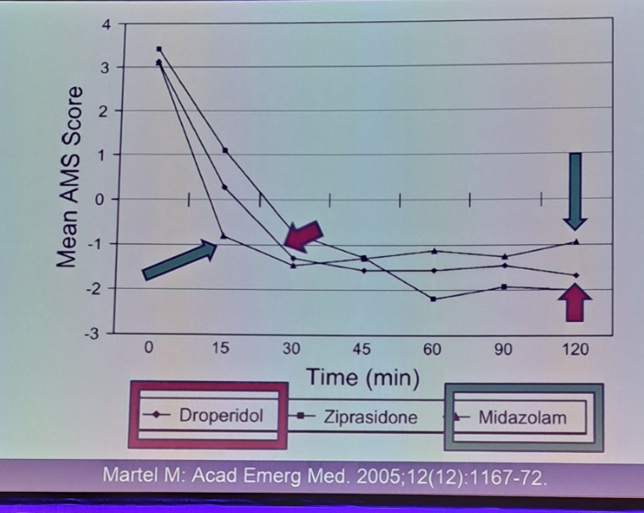
Martel et al. (2005) – Akut agitation behandling
Studie: Randomiserad dubbelblind jämförelse av IM-droperidol, ziprasidone och midazolam.
Resultat:
• Midazolam gav den snabbaste initiala sederingen (15–30 min).
• Droperidol gav jämnare och långvarigare effekt.
• Ziprasidone var långsammare och mindre förutsägbar.

Slide 30
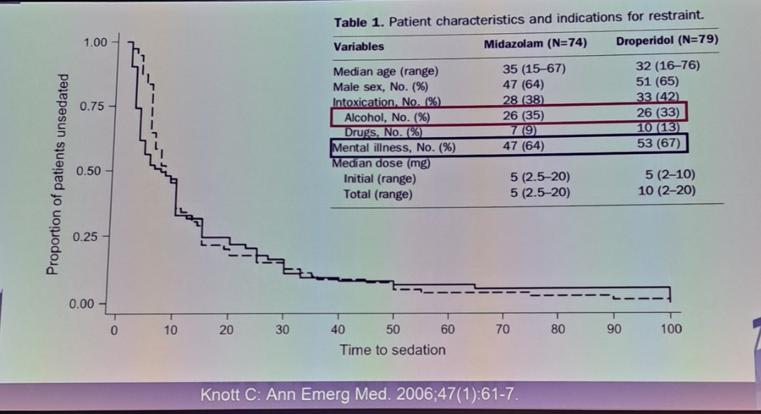
Knott C. 2006 – Patient characteristics and indications for restraint

Slide 31
Etiology – Midazolam vs Ketamine
Etiology | Midazolam first | Ketamine first
Substance use | 53 (33%) | 139 (64%)
Trauma | 30 (19%) | 37 (17%)
Postictal | 26 (16%) | 15 (7%)
Mental health crisis | 10 (6%) | 16 (7%)
Glycemic | 14 (9%) | 2 (1%)
Cardiovascular | 12 (7%) | 2 (1%)
Dyspnea | 9 (6%) | 3 (1%)
Other | 8 (5%) | 0 (0%)

Slide 32
Rescue Sedation after 5 mg or 10 mg of Droperidol
as the Initial Treatment for Acute Agitation in the Emergency Department
Common primary diagnoses at conclusion of ED visit | n (%) | n (%)
Altered mental status | 6126 (59.5) | 598 (46.9)
Alcohol intoxication | 633 (6.1) | 298 (23.4)
Facial or head trauma | 568 (5.5) | 4 (0.3)
Chest pain | 83 (0.8) | 18 (1.4)
Suicidal ideation | 81 (0.8) | 9 (0.7)
Psychosis | 51 (0.5) | 0 (0.0)
Back pain | 43 (0.4) | 5 (0.3)
Drug withdrawal | 37 (0.4) | 3 (0.3)

Slide 33
Ideal Sedating Agent
✓ Easily administered
✓ Quick onset
✓ Moderate duration of action
✓ Good side effect profile
✗ Reversal agent
Ketamine

Slide 34
Systematic review 2018 Ketamin
18 studies, n = 650
Median dose 315 mg IM
Time to sedation 7 min
69% < 5 min
Additional sedation 24%
Mankowitz SL, Regenberg P, Kaldan J, Cole JB. “Ketamine for Rapid Sedation of Agitated Patients in the Prehospital and Emergency Department Settings: A Systematic Review and Proportional Meta-Analysis.” The Journal of Emergency Medicine. 2018 Nov; 55(5):670-681.

Slide 35
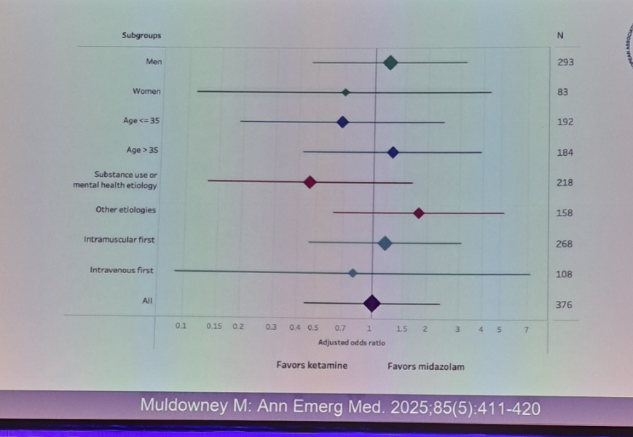
Forest Plot - Ketamine vs Midazolam
Muldowney M, et al. “A Comparison of Ketamine to Midazolam for the Management of Acute Behavioral Disturbance in the Out-of-Hospital Setting.” Annals of Emergency Medicine. 2025 May; 85(5):411-420

Slide 36
Ketamine side effects
Observation | Number | Percent (95% CI)
Laryngospasm | 6/463 | 1.3% (0.3–2.3%)
Hypoxia (not intubated) | 4/220 | 1.8% (0.1–3.6%)
Vomiting | 12/230 | 5.2% (2.3–8.1%)
Emergence | 10/286 | 3.5% (1.5–5.6%)
Hypertension | 12/99 | 12.1% (5.7–18.6%)
Hypersalivation | 32/170 | 18.8% (12.9–24.7%)
Required additional sedation | 114/467 | 24.4% (20.5–28.3%)

Slide 37
“Intubation of Profoundly Agitated Patients Treated with Prehospital Ketamine”
US prehospital series
n = 135
Intubation 63%
Clinician variability
- 0–100% intubation rate
33/85 intubations performed by 2 clinicians
Olives TD, Nystrom PC, Cole JB, Dodd KW, Ho JD. Intubation of Profoundly Agitated Patients Treated with Prehospital Ketamine. Prehosp Disaster Med. 2016 Dec;31(6):593-602. doi: 10.1017/S1049023X16000819. Epub 2016 Sep 19. PMID: 27640730.

Slide 38
Guidelines – Parenteral Sedation
Gather resources required
First dose: Droperidol 10 mg IM
If patient doesn’t settle in 15 minutes → Second dose: Droperidol 10 mg IM/IV
Maximum dose of droperidol is 20 mg per event

Slide 39
Guidelines – Sedation Management
Oral / Initial Sedation
Diazepam 5–20 mg PO
Lorazepam 0.5–2 mg PO
Olanzapine 5–10 mg PO
Sedation assessment in 15 min → if not settled, move to parenteral sedation
Parenteral Sedation
First dose: Droperidol 10 mg IM
If patient doesn’t settle in 15 minutes → Second dose: Droperidol 10 mg IM/IV
Maximum dose of droperidol is 20 mg per event

Slide 40
Droperidol – Sedates, NOT Cures!
• Stop gap…
• Perfect for intoxicated patients
• Perfect for ED patients
• Perfect for violent patient on ward at MIDNIGHT
NOT…
• Treatment of dementia
• Treatment of psychosis
• Treatment of withdrawal syndrome
• Treatment of delirium

Slide 41
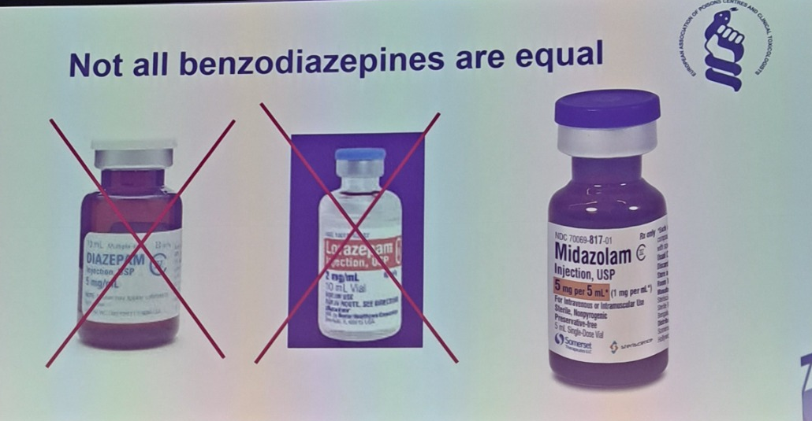

Slide 42
First line therapy in poisoning
Condition | Midazolam | Droperidol | Ketamine
Alcohol intoxication | 🟡 | 🟢 | 👁️
Alcohol withdrawal | 🟢 | 🔴 | 👁️
Cocaine | 🟢 | 🟡 | 👁️
Amphetamines | 🟢 | 🟢 | 👁️
Hallucinogens | 🟢 | 🟡 | 👁️
Unknown | 🟢 | 🟡 | 👁️
I'm going to die! | 🔴 | 🔴 | 🟢

Slide 43
Knott C. 2006 – Patient characteristics
Variable | Midazolam (N=74) | Droperidol (N=79)
Male sex, n (%) | 47 (64) | 51 (65)
Alcohol, n (%) | 26 (35) | 26 (33)
Mental illness, n (%) | 47 (64) | 53 (67)

Slide 44
Baseline characteristics for the 3 treatment groups
 | Droperidol (10 mg) | Midazolam (10 mg) | Droperidol (5 mg) + Midazolam (5 mg)
Number of presentations | 33 | 29 | 29
Alcohol intoxication | 23 (70) | 22 (76) | 19 (66)
Deliberate self-harm | 16 (48) | 12 (41) | 9 (45)
Drug-induced delirium | 2 (6) | 3 (10) | 3 (10)
Acute psychosis | 2 (6) | 1 (3) | 2 (6)
Other | 1 (3) | 0 | 1 (3)

Slide 45
Baseline characteristics for the 3 treatment groups
 | Droperidol (10 mg) | Midazolam (10 mg) | Droperidol (5 mg) + Midazolam (5 mg)
Number of presentations | 33 | 29 | 29
Alcohol intoxication | 23 (70) | 22 (76) | 19 (66)
Deliberate self-harm | 16 (48) | 12 (41) | 9 (45)
Drug-induced delirium | 2 (6) | 3 (10) | 3 (10)
Acute psychosis | 2 (6) | 1 (3) | 2 (6)
Other | 1 (3) | 0 | 1 (3)

Slide 46
EMS Impressions (Cole JB et al, 2016)
 | Ketamine (n) | Haloperidol (n)
Agitated combative | 29 | 21
Substance abuse | 7 | 23
Behavioral | 16 | 8
Altered mental status | 2 | 10
Traumatic injury or mechanism | 4 | 7
Overdose | 0 | 4
Seizure | 0 | 1
Cole JB, Moore JC, Nystrom PC, Orozco BS, Stellpflug SJ, Kornas RL, Fryza BJ, Steinberg LW, O'Brien-Lambert A, Bache-Wiig P, Engebretsen KM, Ho JD. A prospective study of ketamine versus haloperidol for severe prehospital agitation. Clin Toxicol (Phila). 2016 Aug;54(7):556-62. doi: 10.1080/15563650.2016.1177652. Epub 2016 Apr 22. PMID: 27102743.

Slide 47
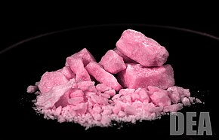
Rosa kokain
En ny partydrog som kallas ”Rosa kokain” trendar, främst bland unga kvinnor. En orsak till drogens popularitet tros vara att den är rosa och doftar jordgubb. Trots namnet är det inte frågan om kokain, utan drogen är en blandning på amfetamin, ketamin, MDMA och andra syntetiska ämnen.

