Slide 1
Nya syntetiska opioder – NSO
2026

Slide 2
Läkemedels- och narkotikaförgiftningar
894 personer avled i Sverige 2019 till följd av läkemedels- och narkotikaförgiftningar
Fortsatt minskning av antalet förgiftningsdödsfall under 2025.
En ny sammanställning visar att 591 personer avled 2025 till följd av förgiftning på grund av läkemedel eller droger under året.
Trenden med ett minskat antal förgiftningsdödsfall sedan 2022, då 815 personer avled av nyss nämnda orsak, fortsätter därmed.

Slide 3
Long‐term mortality and cause of death for patients treated in Intensive Care Units due to poisoning
Elin Lindqvist1,2 | Gunnar Edman3,4 | Jacob Hollenberg2 | Per Nordberg2 | Sune Forsberg1,2
Background: Poisoned patients treated in the Intensive Care Unit are common, representing up to 6% of all ICU admissions.
The in‐hospital mortality is generally low but little is known about the long‐term mortality in these patients. The aim of this study was to describe long‐term mortality and cause of death in patients treated in the ICU for poisoning

Slide 4
Long‐term mortality and cause of death for patients treated in Intensive Care Units due to poisoning
Elin Lindqvist1,2 | Gunnar Edman3,4 | Jacob Hollenberg2 | Per Nordberg2 | Sune Forsberg1,2
Results: A total of 6730 patients were included.
The one‐year mortality was 4.5% (n = 303), with an overweight of men among the deceased (59.1%, P = 0.002).
Patients aged 19‐39 years had a 48 times increased one‐year mortality compared to the age‐matched general population and 94% of these patients died from suicide and/or accident, of which 70% were from a new poisoning.
The two‐year mortality was 7.2%.
Women have a slightly higher overall long‐term survival over two years (P< 0.001)
Poisoning is also the most common method in self‐harm, accounting for 80%‐95%

Slide 5
Kraftig minskning bland heroinrelaterade dödsfall
Jämfört med åren före pandemin ses en fortsatt och kraftig minskning av antalet dödsfall kopplade till heroin.
År 2019 konstaterades 111 heroinrelaterade förgiftningsdödsfall bland de rättsmedicinska obduktionsärendena.
För 2024 var antalet nere på 44, medan motsvarande siffra för 2025 var 15, enligt den preliminära statistiken.

Slide 6
Heroin
Reports on heroin vary by region. Overall, experts tend to report a decline in the availability and prevalence of heroin.
The active ingredient content fell sharply in 2024, making the adulteration of other substances more likely. The first instances of adulteration were confirmed in 2025 in locations including Bremen, Frankfurt am Main and Hanover.
For some users, a shift towards various other substances has been reported; these include crack, cocaine, fentanyl, opioid-containing painkillers, substitution drugs and synthetic opioids.
Whilst the traditional ‘heroin scene’ appears to be in decline in some places, there are isolated reports from other regions of younger heroin users reappearing.

Slide 7
Heroin
“There’s simply hardly any heroin left on the black market, and when there is, it’s so poor quality that nobody wants it anymore. The effect isn’t what you’d hope for either.”
“Heroin hasn’t played a role here for years; instead, there is much higher consumption of opioids such as oxycodone, fentanyl, tilidine, etc., particularly among young adults.”
“The deterrent effect of heroin has diminished in recent years. The new ‘generation’ of drug users is no longer familiar with the ‘old negative image’ from the 90s.”
“'Classic heroin overdoses involving respiratory depression are in sharp decline here. A link with the purity levels, which are likely to continue falling, seems obvious.”

Slide 8
Flest dödsfall kopplas till oxikodon
De substanser som bidragit till flest dödsfall under 2025 är oxikodon, följt av zopiklon och buprenorfin
Vanligast förekommande är alltjämt bensodiazepiner, opioider och sömnmedel och där de två förstnämnda är vanliga vid förgiftningsdödsfall medan sömnmedel oftare förekommer vid självmord

Slide 9
Dödsår | 2021 | 2022 | 2023 | 2024 | 2025***
Rättsmedicinska obduktioner ** | 5804 | 5918 | 5978 | 5377 | 5130
Förgiftningar (läkemedel/droger) | 723 | 815 | 782 | 688 | 591
Oxikodon | 100 | 108 | 96 | 105 | 93
Zopiklon | 58 | 85 | 79 | 68 | 77
Buprenorfin | 89 | 95 | 71 | 67 | 56
Propiomazin | 42 | 65 | 63 | 54 | 55
Alimemazin | 63 | 73 | 63 | 54 | 54
Alprazolam | 78 | 91 | 106 | 76 | 52
Pregabalin | 40 | 41 | 50 | 48 | 48
Tramadol | 61 | 51 | 63 | 44 | 44
Metadon | 40 | 57 | 62 | 45 | 42
Kokain | 8 | 23 | 36 | 16 | 30
Prometazin | 30 | 31 | 22 | 30 | 27
Amfetamin | 42 | 52 | 51 | 39 | 26
Paracetamol | 22 | 26 | 31 | 24 | 25
Sertralin | 18 | 22 | 19 | 11 | 24
Venlafaxin | 23 | 29 | 25 | 24 | 23
Diazepam | 21 | 22 | 34 | 37 | 22
Gabapentin | 17 | 21 | 18 | 26 | 22
Mirtazapin | 33 | 40 | 32 | 31 | 20
Loperamid | 7 | 11 | 10 | 13 | 17
Kodein | 18 | 14 | 13 | 16 | 16
Kvetiapin | 22 | 14 | 16 | 9 | 16
Heroin | 67 | 78 | 60 | 44 | 15
Amitriptylin | 27 | 25 | 21 | 20 | 15
Citalopram | 15 | 22 | 13 | 23 | 15
Fentanyl | 17 | 17 | 19 | 18 | 15
Olanzapin | 12 | 7 | 11 | 15 | 15

Slide 10
TRENDSPOTTER UPDATE
Synthetic opioids
March 2026
Dr Heiko Bergmann, Dr Franziska Schneider, Anna-Mavie Beil, Magdalena Janz & Esther Neumeier

Slide 11
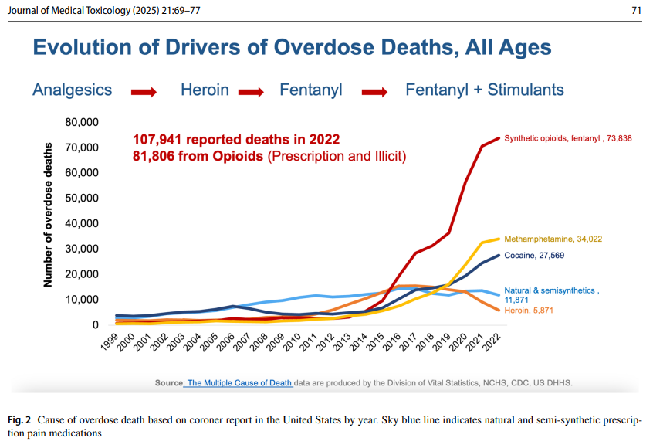

Slide 12
New synthetic opioids (NSO)
New synthetic opioids (NSO), which have no medical use, include, amongst others, the substance classes of nitazene, orphine and fentanyl.
As of 16th of March 2026, 101 NSO are under observation in Europe
Some substances in these classes are more than 100 times stronger than heroin

Slide 13
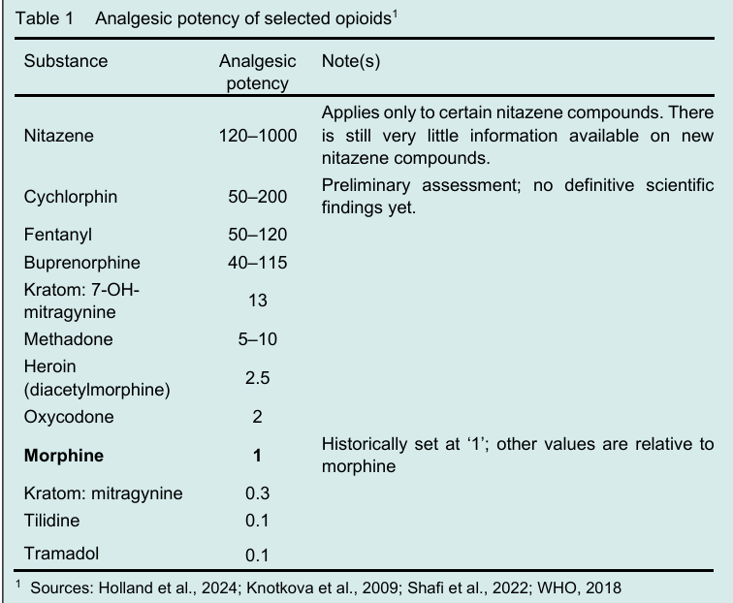

Slide 14
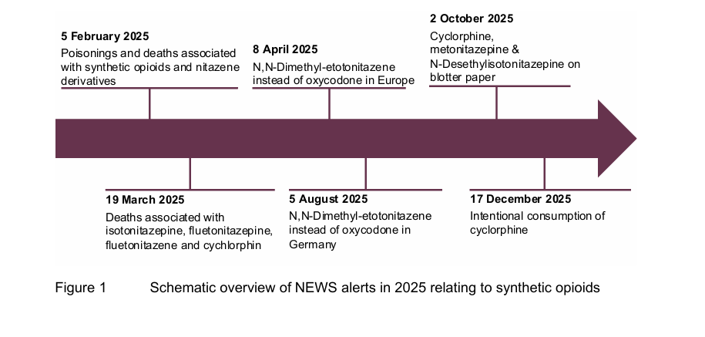
New synthetic opioids (NSO)

Slide 15
Counterfeit tablets and ‘hidden’ new synthetic opioids
In spring 2025, for instance, the Bavarian State Criminal Police Office (LKA Bayern) seized a total of 290 suspected oxycodone tablets (Mundipharma, 80 mg) which, instead of oxycodone, contained the nitazene N,N dimethyletonitazene.
In August 2025, the Berlin State Criminal Police Office (LKA Berlin) also reported counterfeit Oxycodone tablets containing the same nitazen as the tablets from Bavaria.
At the end of September 2025, the University Medical Centre Freiburg issued Germany’s first warning about counterfeit benzodiazepine tablets containing highly potent opioids:
These contained cychlorphin, which, according to the latest pharmacological studies, is more potent than fentanyl (EUDA et al., 2026). Cychlorphin also featured in a report from Karlsruhe in December 2025 and a report from January 2026:
In Karlsruhe, the deliberate consumption of cychlorphin was confirmed for the first time among a group of high-risk drug users.

Slide 16
Counterfeit tablets and ‘hidden’ new synthetic opioids
In 2025, state criminal investigation offices, of counterfeit oxycodone or (prodrug) benzodiazepine tablets containing highly potent NSOs.
These products are virtually indistinguishable from genuine medicines in appearance and carry a very high risk of poisoning.
Around one-fifth of the experts surveyed noted changes in counterfeit tablets, including reports of poisonings and deaths following the consumption of tablets purchased online that had been sold as opioid medication or benzodiazepines.

Slide 17
Counterfeit tablets and ‘hidden’ new synthetic opioids
In January 2026, we issued a warning in the NEWS project regarding yellow tablets that were presumably being sold in a specialist online shop as Alpravizafon (a purported benzodiazepine prodrug), but which also contained cychlorphin and methiodone.
Methiodone is a methadone derivative that is also offered as a research chemical in online shops. Tablets of similar appearance and composition have been linked to a fatality.

Slide 18
Counterfeit tablets and ‘hidden’ new synthetic opioids
“Younger people in particular have found their way to opioids e .g. tilidine, tramadol, codeine, oxycodone) during their teenage years due to influences from popular culture.
Several people (< 30 years old) stated in 2025 that this was how they first became addicted.
As their addiction progressed in young adulthood, these individuals then switched to nitazene and fentanyl. Relatively high doses in particular became the norm later on.” Expert from a drug consumption room)

Slide 19
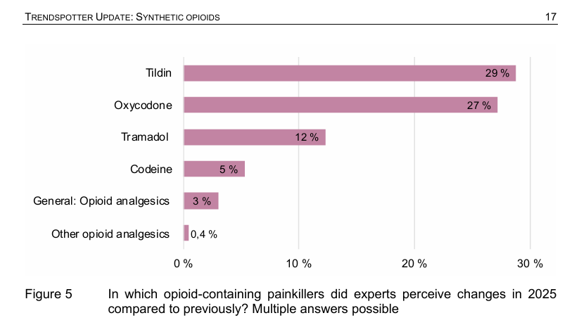
Counterfeit tablets and ‘hidden’ new synthetic opioids

Slide 20
Counterfeit tablets and ‘hidden’ new synthetic opioids
“I have observed that an increasing number of young adults and adolescents are using opioid-containing medicines, leading to them requiring treatment for overdoses, severe discomfort and non-fatal poisoning.”
(Expert from a counselling centre in western Germany)

Slide 21
Opioid-containing painkillers (tilidine, oxycodone, etc.)
39 % of respondents noted changes in opioid-containing painkillers;
tilidine (29 % of mentions) and oxycodone (27 %) stand out in particular.
Although the substances have different potencies, the responses for both substances are virtually identical in content. Experts report a marked increase in consumption among adolescents and young adults, often within the context of polyvalent patterns of use.
The sources of supply are diverse: dealers, social circles, online shops and messaging services (e. g. Telegram groups advertised via Instagram/TikTok, where drugs are ordered ‘like a pizza’), resale in school playgrounds, and in some cases also careless prescribing and prescription forgeries.
In the treatment of already established addiction problems (inpatient rehabilitation, detoxification, substitution), an increase in younger clients is evident.

Slide 22
Fentanyl
26 % of experts report changes relating to fentanyl, particularly in the south and north-east of Germany.
Fentanyl use is primarily associated with individuals who were already engaging in high-risk drug use, but also with young adults.
Fatalities involving fentanyl rose from 72 to 98 cases between 2023 and 2024, mostly in cases of poly-drug use.

Slide 23
Substitution drugs
12 % of experts report changes in the misuse of substitution drugs such as (levo-)methadone and buprenorphine, including an increase among young users and the impression that substitution drugs are perceived as ‘purer’ and safer than, for example, heroin.

Slide 24
New synthetic opioids (NSOs)
According to the EUDA database, NSOs currently (as of 16 March 2026) comprise 101 observed substances, some of which are very potent (in some cases significantly more than fentanyl) and, due to their novelty, often present risks that have scarcely been researched.
Changes were reported primarily for nitazene (17 %), with regional concentrations in the south and north-east.
Nitazene appeared both as adulterants in heroin (e. g. a cluster of emergencies in Bremen in 2025) and in counterfeit oxycodone tablets, and was linked to nine deaths in 2024.
Following the inclusion of numerous nitazene, opiate and methadone derivatives under the New Psychoactive Substance Act in December 2025, many of these substances disappeared from German ‘research chemicals’ shops; forum analysis and laboratory data since then suggest a decline in their prevalence. It remains to be seen which products will fill the resulting gap.

Slide 25
'Frankenstein' opioids on streets, much stronger than Fentanyl
Nitazener
Under mitten av 1950-talet ledde försök att utveckla bättre och säkrare opioidanalgetika till upptäckten av en serie 2-bensylbensimidazolföreningar med nivåer av analgetisk styrka flera storleksordningar högre än morfinets.
I likhet med andra typer av opioidanalgetika som morfin och fentanyl, aktiverar 2-bensylbensimidazolföreningarna μ-opioidreceptorerna i det centrala nervsystemet.
Det förväntas att effekterna av sådana föreningar sannolikt har likheter med fentanyl och andra opioidanalgetika.

Slide 26
Nitazener
De akuta effekterna inkluderar: eufori, avslappning, analgesi, sedering (som framkallar ett tillstånd av lugn eller sömn), bradykardi, hypotermi och andningsdepression (långsammare andning).
Det är denna sistnämnda effekt som utgör den största faran för användarna, eftersom små mängder, på grund av den uppenbarligen höga styrkan hos vissa av dessa föreningar, kan orsaka livshotande förgiftning av andningsdepression.
Om det inte behandlas kan detta leda till andningsstopp och död.
Denna risk kan förvärras genom användning av andra medel som dämpar centrala nervsystemet (alkohol och benso) .

Slide 27
Nitazener
N,N-diethyl-2-[[4-(1- methylethoxy)phenyl]methyl]-5-nitro-1Hbenzimidazole-1-ethanamine (isotonitazene)
Isotonitazene
Clonitazene
Etonitazene
Metonitazene

Slide 28
'Frankenstein' opioids on streets, much stronger than Fentanyl
Nitazener
Isotonitazene has been detected in Estonia since 2019, and other nitazenes such as protonitazene and metonitazene have been increasingly identified in post-mortem analyses of drug-related deaths cases since 2022. In 2022, 32 of 82 drug-related deaths (39%) in Estonia were associated with nitazenes and 2 of 63 (3%) in Latvia.
In 2023, nitazenes were identified in 56 of 117 drug-related deaths (48%) in Estonia and in 38 of 130 (29%) in Latvia. This development is worrying. In drug-related death cases involving nitazenes, the most prominent nitazenes detected in Estonia in 2023 were protonitazene (38 of 56; 68%) and metonitazene (27 of 56; 48%); isotonitazene (32 of 38; 84%) was most common in Latvia.

Slide 29
Nitazener
Although the high analgesic potency renders the manufacture of this series of compounds attractive to clandestine chemists, until the first identification of isotonitazene in 2019, when it was first identified on the illicit drug market, only etonitazene had been sporadically encountered on the drug market. As of 26 May 2020, isotonitazene is the only substance from the 2-benzylbenzimidazole series of opioid analgesics notified to the EMCDDA as an NPS

Slide 30
Kratom and kratom products
19 % of experts report developments regarding kratom and kratom products (mitragynine, 7-OH-mitragynine), which are primarily consumed by adolescents and young adults.
Kratom is predominantly purchased via Clearnet online shops, mostly as herbal powder, but also as high-dose 7-OH products, the potency of which, according to the US Food and Drug Administration (FDA), can be around 13 times higher than that of morphine.
Kratom is downplayed in marketing and is frequently used as part of polyvalent consumption, including for the self-treatment of withdrawal symptoms.
There are reports from individual German clinics of kratom users with withdrawal syndromes who require treatment with conventional substitution medications.

Slide 31
Overall assessment
There is still no sign of an acute opioid crisis.
However, the critical developments already reported in the first Trendspotter have continued. In the short term, the presence of NSO as adulterants in heroin or in counterfeit tablets increases the risk of local or widespread clusters of poisoning, which are difficult to detect due to limited toxicological analysis and delayed reporting. The first cases of intoxication of this kind were reported in 2025.
Due to gaps in monitoring coverage, it must be assumed that many cases went undetected.
A potentially significant long-term trend is emerging in the form of a growing group of young people who use opioids (primarily medicines, and in some cases NSO and heroin), some of whom have already developed a dependency.
This is evident from a trend towards younger patients in inpatient rehabilitation and reports from substitution therapy. Given the chronic nature of addiction, it is plausible that these individuals will require long-term support.

Slide 32
Overall assessment
According to experts, the key drivers behind the dynamics described among young people are the wide range of substances available, their easy online accessibility, aestheticisation and glorification on social media and within subcultural scenes (including rap), as well as the positive image associated with them, coupled with a lack of specific prevention measures and low-threshold access to support for young people.
Added to this are psychological stresses and a generally observed trend towards polyvalent substance use.
Accordingly, there are frequent calls for specific prevention services for adolescents and young adults, as well as for strengthening addiction counselling and treatment specifically for younger people.

