Slide 1
ILE
Intravenös fettbehandling vid allvarliga intoxikationer

Slide 2
Intravenös fettbehandling (ILE) mekanism
Three mechanisms of action that may benefit ILE have been suggested. The first and favored proposed mechanism is the formation of a ‘lipid sink’, sequestering lipophilic toxin within it, thus reducing effect site toxicity.
Second, ILE might increase intracellular fatty acid content and thereby increase high energy phosphate content in the intoxicated heart.
Third, fatty acids might confer a direct inotropic action by increasing cardiac myocyte calcium levels via action on calcium ion channels.

Slide 3
I händelse av cirkulationsstillestånd ska hjärt-lungräddning utföras omedelbart och lipidbehandling (ILE) kan prövas
Ge bolus av en 20 % lipidemulsion (Intralipid), 1,5 ml/kg i.v. alt 100 ml snabbt intravenöst.
Starta en infusion med en lipidemulsion 0,25 ml/kg/min i 10 min, under tiden som hjärt-lungräddning utförs, alt. 100 ml intravenöst.
Om blodtrycket sjunker öka infusionshastigheten med 0.5 ml/kg/min
Bolusdoser kan upprepas var 5:e minut, två eller tre gånger om det behövs, 1,5 ml/kg Intralipid.
Mer än 8 ml/kg lipidemulsion bör ej ges totalt (560 ml till 70 kg:s patient). Avbryt infusionen efter stabiliserad cirkulation.

Slide 4
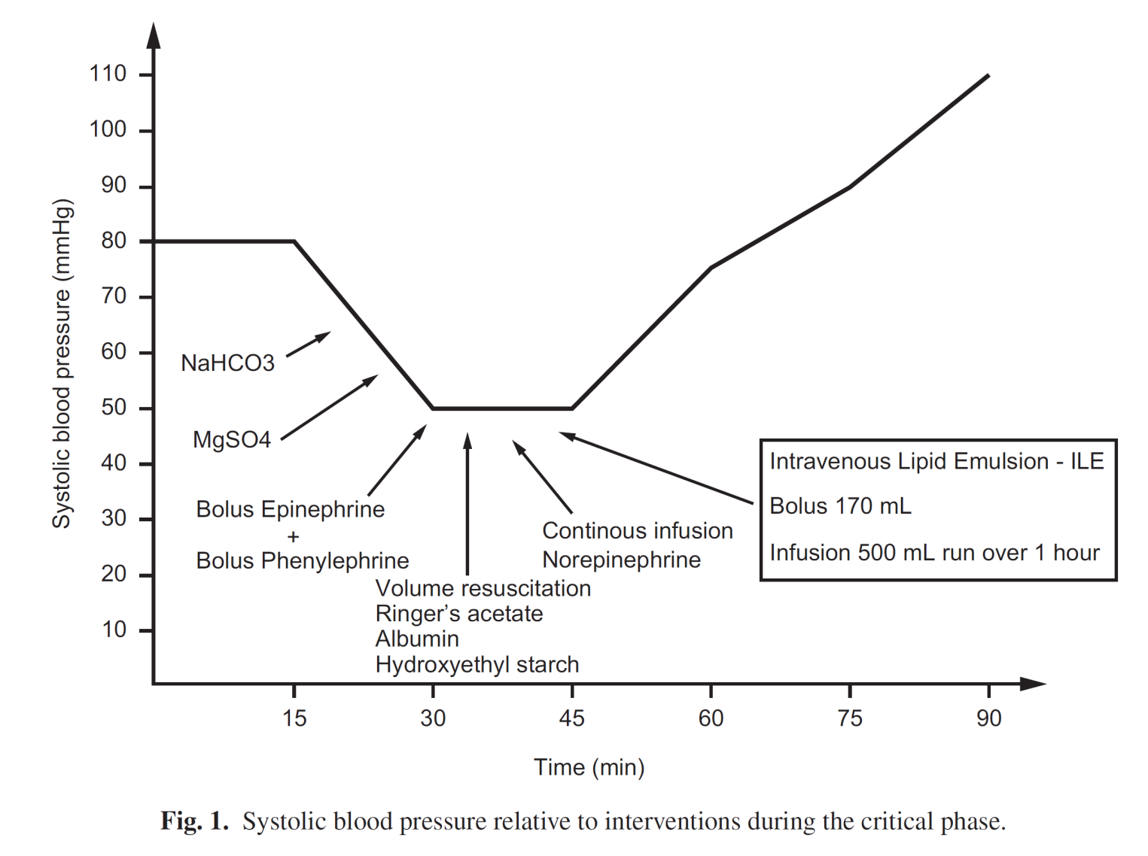
Use of intravenous lipid emulsion in the resuscitation of a patient with cardiovascular collapse after a severe overdose of quetiapine
MALIN BARTOS 1 and KAI KNUDSEN 2
Clinical Toxicology (2013), 51, 501–504

Slide 5
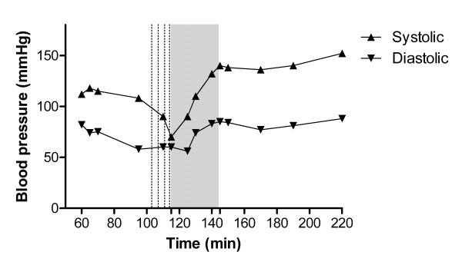
TCA poisoning. Blood pressure vs. time from drug ingestion. Dotted lines represent metaraminol injection. Grey panel represents duration of ILE infusion.

Slide 6
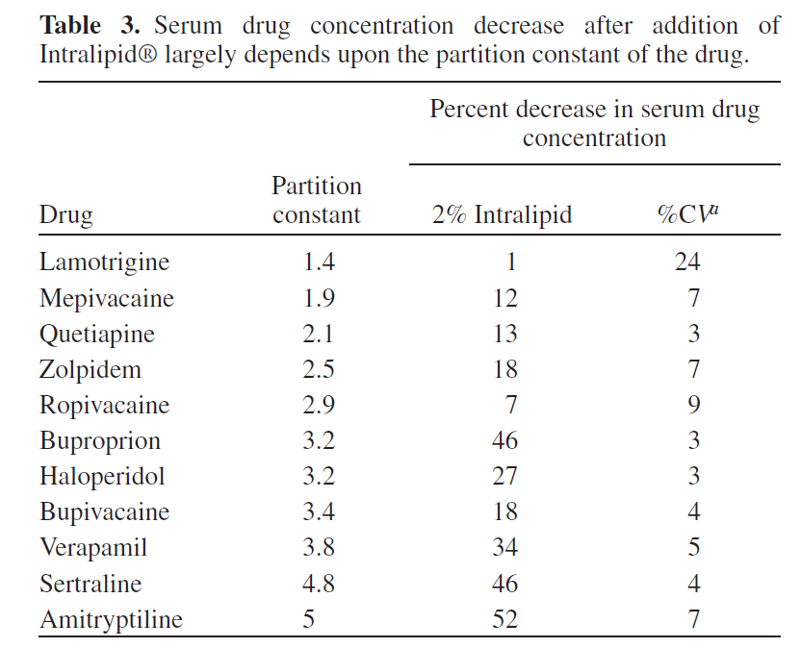
Partition constant and volume of distribution as predictors of
clinical efficacy of lipid rescue for toxicological emergencies

Slide 7
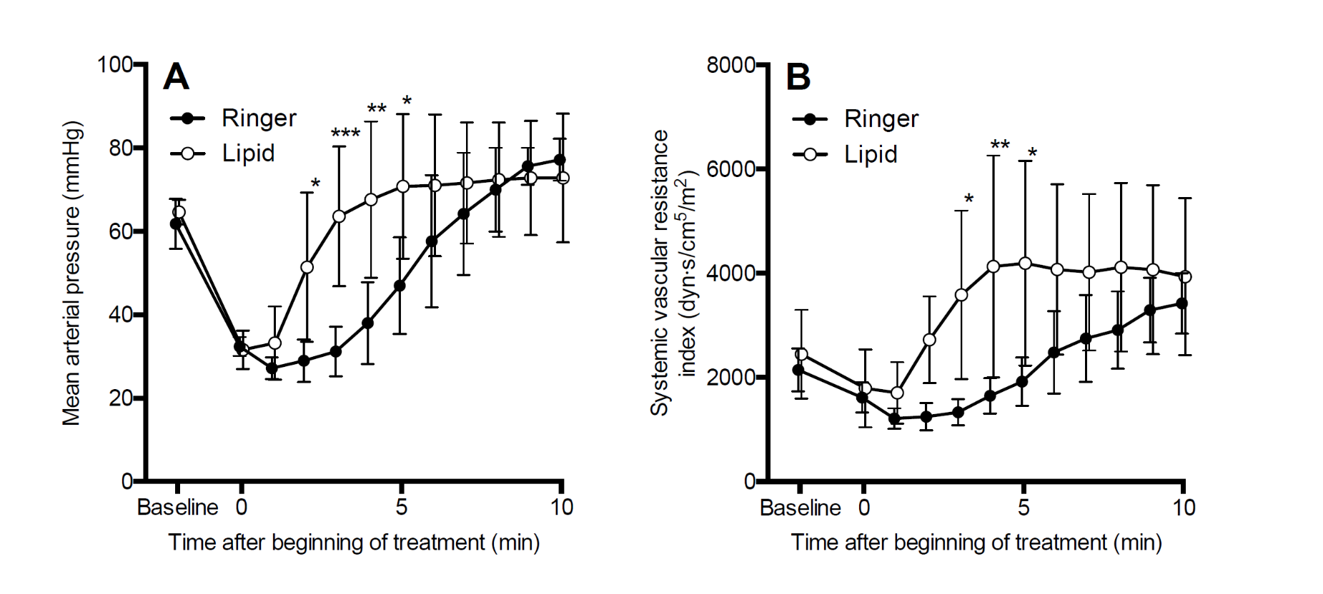
Mean arterial pressure and systemic vascular resistance index
Figure 3
After bupivacaine toxicity, lipid emulsion 4 ml/kg in 1 min i.v. improved the recovery of mean arterial pressure (A): the treatment-time interaction was significant (F [10, 80] = 7.5, p < 0.0001). B. The increase in arterial blood pressure was accompanied by a significant treatment-time interaction of mean systemic vascular resistance index (F [10, 80] = 6.2, p < 0.0001). In Sidak posttesting ***p < 0.001, **p < 0.01, *p < 0.05 between the groups.

Slide 8
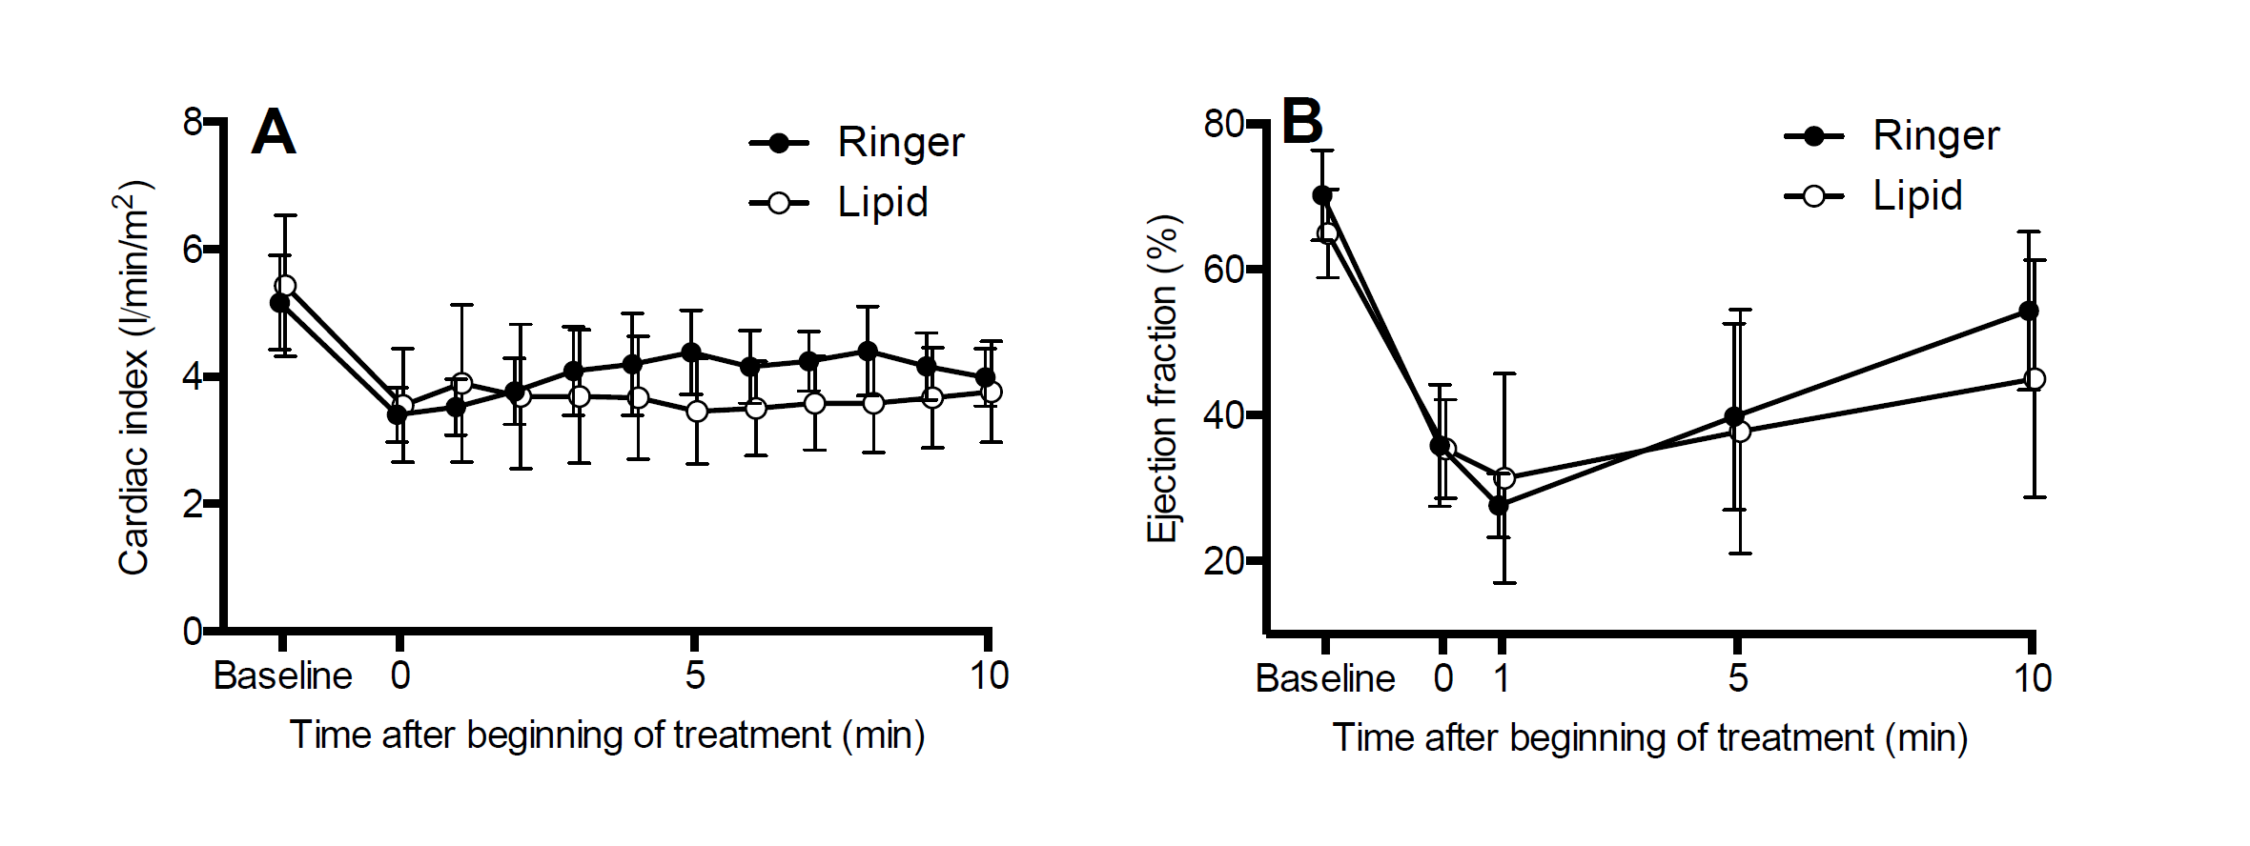
Cardiac index and left ventricular ejection fraction
Figure 4.
After bupivacaine toxicity, lipid emulsion 4 ml/kg in 1 min did not affect the cardiac index (A) or the left ventricular ejection fraction (B). The interaction over time of mean cardiac index was significant (p = 0.01). In Sidak post-testing there was, however, no difference at any time points between the groups. The interaction over time of the recovery of left ventricular ejection fraction was not statistically significant.

Slide 9
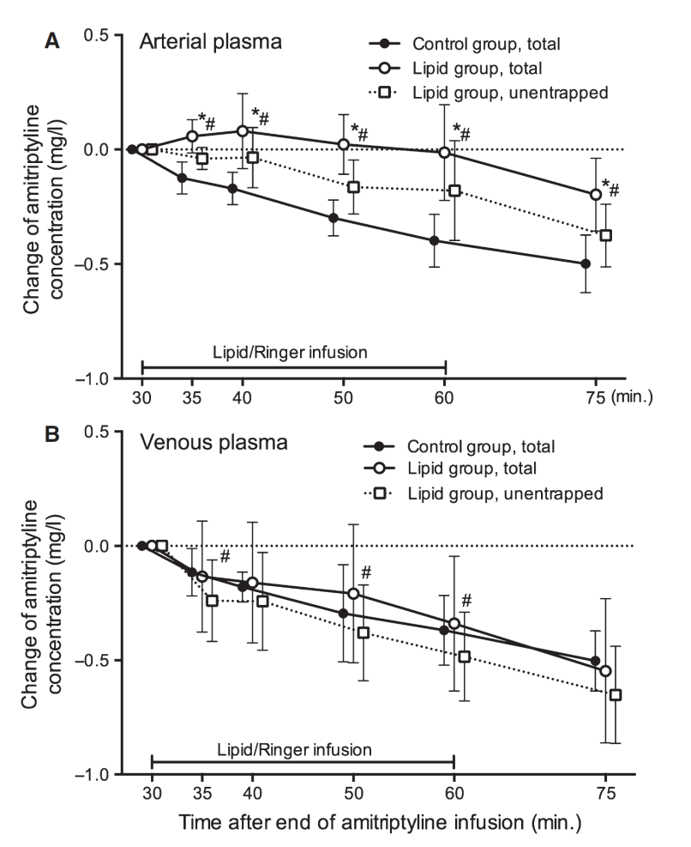
Change in amitriptyline concentration
Fig. 4. The changes in arterial (A) and venous (B) plasma amitriptyline concentrations compared with the concentrations at the start of treatment infusions. Note that the arterial plasma total amitriptyline concentration remained stable or increased during the lipid infusion. In the Control group, arterial plasma total amitriptyline concentration decreased throughout the experiment. The differences between the Lipid and Control groups are smaller in venous plasma. Values are means and standard deviations of 10 pigs in each group. *Difference in plasma total amitriptyline concentration changes between the Lipid and Control groups p < 0.05. #Difference in plasma total and unentrapped amitriptyline concentration changes within the Lipid group p < 0.05.

Slide 10
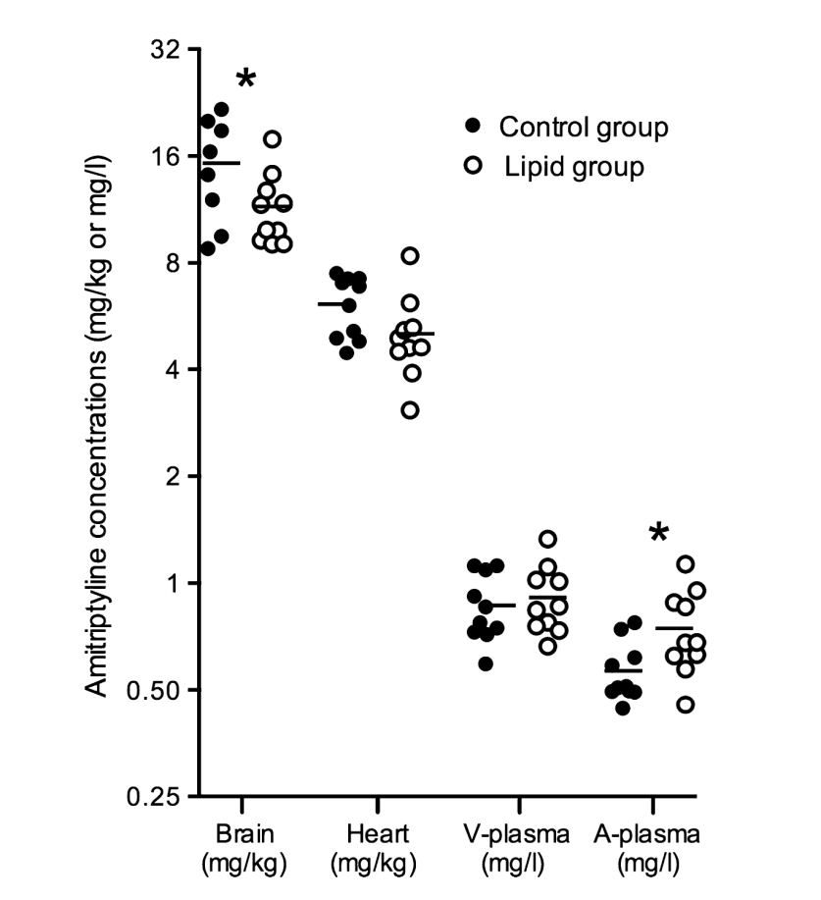
Amitriptyline concentrations in tissues
Fig. 5. Total amitriptyline concentrations in brain and heart tissues and in plasma at the end of experiment. Brain tissue samples were taken approximately 10 min. and heart tissue samples approximately 25 min. later than the blood samples (at 75 min.). Line indicates mean value. V-plasma means venous plasma, A-plasma means arterial plasma. *Difference in brain and arterial plasma total amitriptyline concentrations between the Lipid and Control groups p < 0.05.

Slide 11
Systematic review of the effect of intravenous lipid emulsion therapy for local anesthetic toxicity
Lotte C. G. Hoegberg, Theodore C. Bania, Valéry Lavergne, Benoit Bailey, Alexis F. Turgeon, Simon H. L. Thomas, Martin Morris, Andrea Miller-Nesbitt, Bruno Mégarbane, Sheldon Magder, Sophie Gosselin & Lipid Emulsion
Workgroup
Clinical Toxicology
2016: 54:3, 167-193, DOI: 10.3109/15563650.2015.1121270
Following national and regional recommendations, intravenous lipid emulsion (ILE) has
become established in clinical practice as a treatment for acute local anesthetic (LA) toxicity, although
evidence of efficacy is limited to animal studies and human case reports

Slide 12
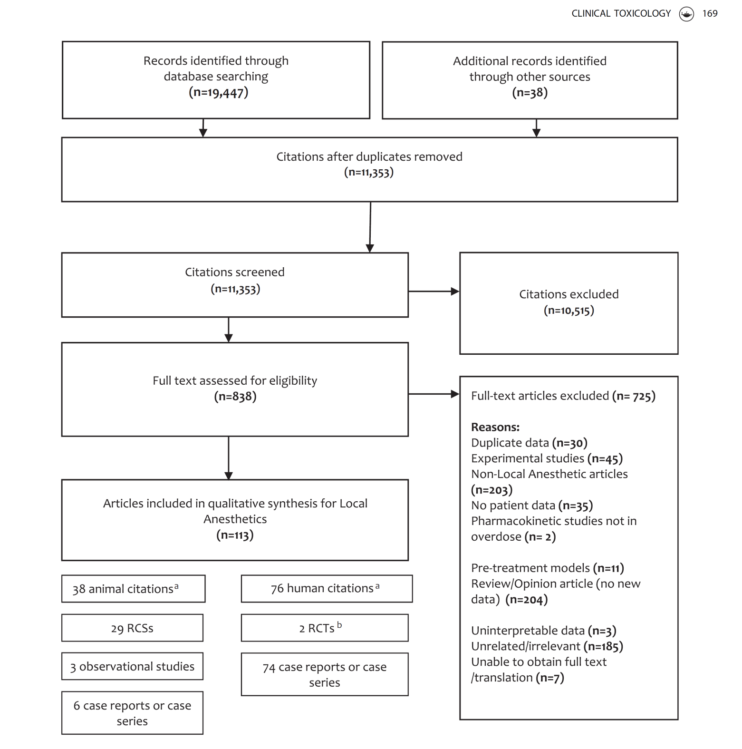

Slide 13
Results: We included 113 studies and reports. Of these, 76 were human and 38 animal studies. One publication included both a human case report and an animal study. Human studies included one randomized controlled crossover trial involving 16 healthy volunteers.
The subclinical LA toxicity design did not show a difference in the effects of ILE versus saline.
There was one case series and 73 case reports of ILE use in the context of toxicity (83 patients) including CNS depression or agitation (n 45, 54%), seizures (n 49, 59%), hypotension, hypertension, EKG changes, arrhythmias (n 39, 47%), cardiac arrest (n 18, 22%), cardiopulmonary resuscitation, and/or requirement for endotracheal intubation and/or mechanical ventilation (n 35, 42%).
There were 81 (98%) survivors including 63 (76%) with no reported sequelae from the LA poisoning or ILE, although the presence or absence of sequelae was not reported in 15 (18%) cases.

Slide 14
Animal studies included 29 randomized controlled studies, three observational studies, five case series, and one case report; bupivacaine was used in 29 of these reports (76%). Of 14 controlled experiments in animals, eight showed improved survival or time to return of spontaneous circulation and five no benefit of ILE versus saline or non-ILE treatments. Combining ILE with epinephrine improved survival in five of the six controlled animal experiments that studied this intervention.
The studies were heterogeneous in the formulations and doses of ILE used as well as the doses of LA.
The body of the literature identified by this systematic review yielded only a very low quality of evidence.
Conclusion: ILE appears to be effective for reversal of cardiovascular or neurological features in some cases of LA toxicity, but there is currently no convincing evidence showing that ILE is more effective than vasopressors or to indicate which treatment should be instituted as first line therapy in severe LA toxicity.

Slide 15
Systematic review of the effect of intravenous lipidemulsion therapy for non-local anesthetics toxicity
Michael Levine, Robert S. Hoffman, Valéry Lavergne, Christine M. Stork, Andis Graudins, Ryan Chuang, Samuel J. Stellpflug, Martin Morris, Andrea Miller-Nesbitt, Sophie Gosselin & for the Lipid Emulsion Workgroup*
Clinical Toxicology, 2016: 54:3, 194-221,
DOI: 10.3109/15563650.2015.1126286

Slide 16
Systematic review of the effect of intravenous lipid emulsion therapy for non-local anesthetics toxicity
Conclusions: Despite the use of ILE for multiple substances in the treatment of patients with poisoning and overdose, the effect of ILE in various non-local anesthetic poisonings is heterogenous, and the quality of evidence remains low to very low.

Slide 17
I händelse av cirkulationsstillestånd ska hjärt-lungräddning utföras omedelbart och lipidbehandling (ILE) kan prövas
Ge bolus av en 20 % lipidemulsion (Intralipid), 1,5 ml/kg i.v. alt 100 ml snabbt intravenöst.
Starta en infusion med en lipidemulsion 0,25 ml/kg/min i 10 min, under tiden som hjärt-lungräddning utförs, alt. 100 ml intravenöst.
Om blodtrycket sjunker öka infusionshastigheten med 0.5 ml/kg/min
Bolusdoser kan upprepas var 5:e minut, två eller tre gånger om det behövs, 1,5 ml/kg Intralipid.
Mer än 8 ml/kg lipidemulsion bör ej ges totalt (560 ml till 70 kg:s patient). Avbryt infusionen efter stabiliserad cirkulation.

Slide 18
Adverse Effects
ILE is early, and less frequent adverse effects include allergic reactions, dyspnea, hyperlipidemia, hypercoagulability, and irritation. ILE's delayed and less frequent adverse effects include transient elevation of liver function test values, hepatomegaly, splenomegaly, and thrombocytopenia.[14]
According to AHA guidelines for Special Circumstances of Resuscitation, ILE administration may increase the absorption of lipophilic drugs from the GIT.
ILE can also interfere with the function of venoarterial extracorporeal membrane oxygenation circuits.[2] As parenteral nutrition, adverse reactions of lipid emulsion treatment are infection, hyperlipidemia, acute pancreatitis, decreased immune response, interference with laboratory examinations using serum, and parenteral nutrition-associated hepatic diseases.
In addition, hyperlipidemia and infection can be associated with impaired reticuloendothelial function, leading to impaired pulmonary gas exchange.
However, the adverse effects of lipid emulsion infusion are mild and transient for a short-term infusion compared with the fatal complications, such as cardiovascular depression and cardiac arrest, induced by toxic doses of local anesthetic, which require immediate lipid emulsion treatment.[14] Acute kidney injury, ventilation-perfusion mismatch, venous thromboembolism, and fat embolism have been reported.[20]

Slide 19
